Slide 1
PROJECT
TOPIC : BLOCKCHAIN FOR CYBERSECURITY
MEMBERS: SRINITYA. K

Slide 2
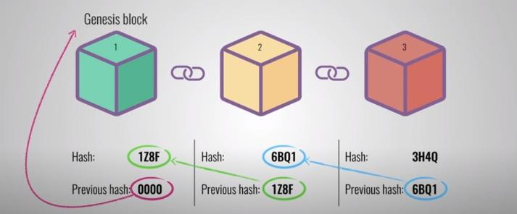
INTRODUCTION:
A Block chain is a chain of blocks that contains a set of information.
A blockchain is explained as a distributed ledger that is accessible to everyone within the network.
At the closet, each block contains data, the hash of the block and the hash of the previous block.

Slide 3
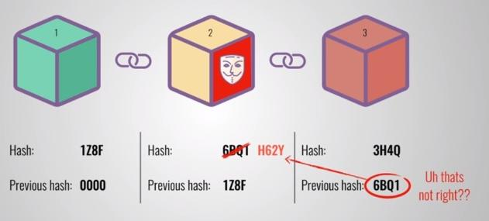
If the second block is tampered , the hash of the block changes as well. In turn this will make block number 3 and the following blocks invalid as they no longer store valid hash of previous block. Changing a single block will make all following blocks invalid.
To overcome, we can effectively tamper with a block and recalculate all the hashes of other blocks to make the blockchain valid. So to mitigate this , blockchains have proof-of-work’.

Slide 4
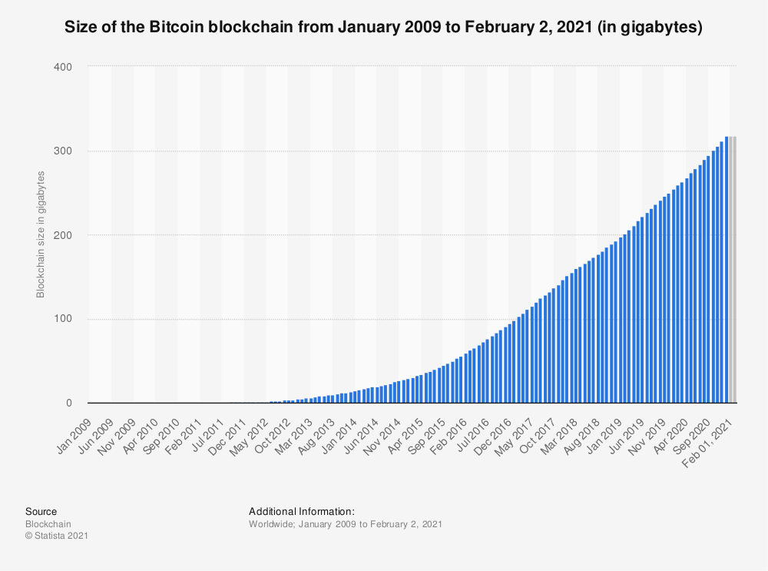
OBJECTIVE
Blockchain can be used to prevent unauthorized access to data in transit. By utilizing the encryption feature of the technology, data transmission can be secured to prevent malicious activities, be it in an organization or an individual.

Slide 5
A step back to cybersecurity, we see the CIA triad and its concept has been around Confidentiality, Integrity and Availability.
With confidentiality, a good level of encryption is used to say that it can not be broken, contrastingly anything can be broken but within reason it cannot. So the communications are kept secret.
Integrity, the idea is that if any transaction takes place we can verify that somebody actually made the transaction and we can verify within a very good level of certainty that the transaction is being tampered with.
Availability-distributed nature of blockchain , which says that if a certain system has been taken out, many other peers can automatically update themselves.

Slide 6
GROUNDED THEORY
Over 10 years after Bitcoin's initial release of its application through Bitcoin working rule, the community still agonizes from a lack of lucidity regarding what are the properties that define blockchain technology, its relationship to other alike technologies and which of the proposed use-cases are viable.
Preceding studies on the security and privacy of blockchain technology have revealed that many applications have fallen ill to cyberattacks
the cybersecurity industry can aid from blockchain’s distinctive traits, which create a virtual inaccessible wall between an attacker and user’s information.

Slide 7
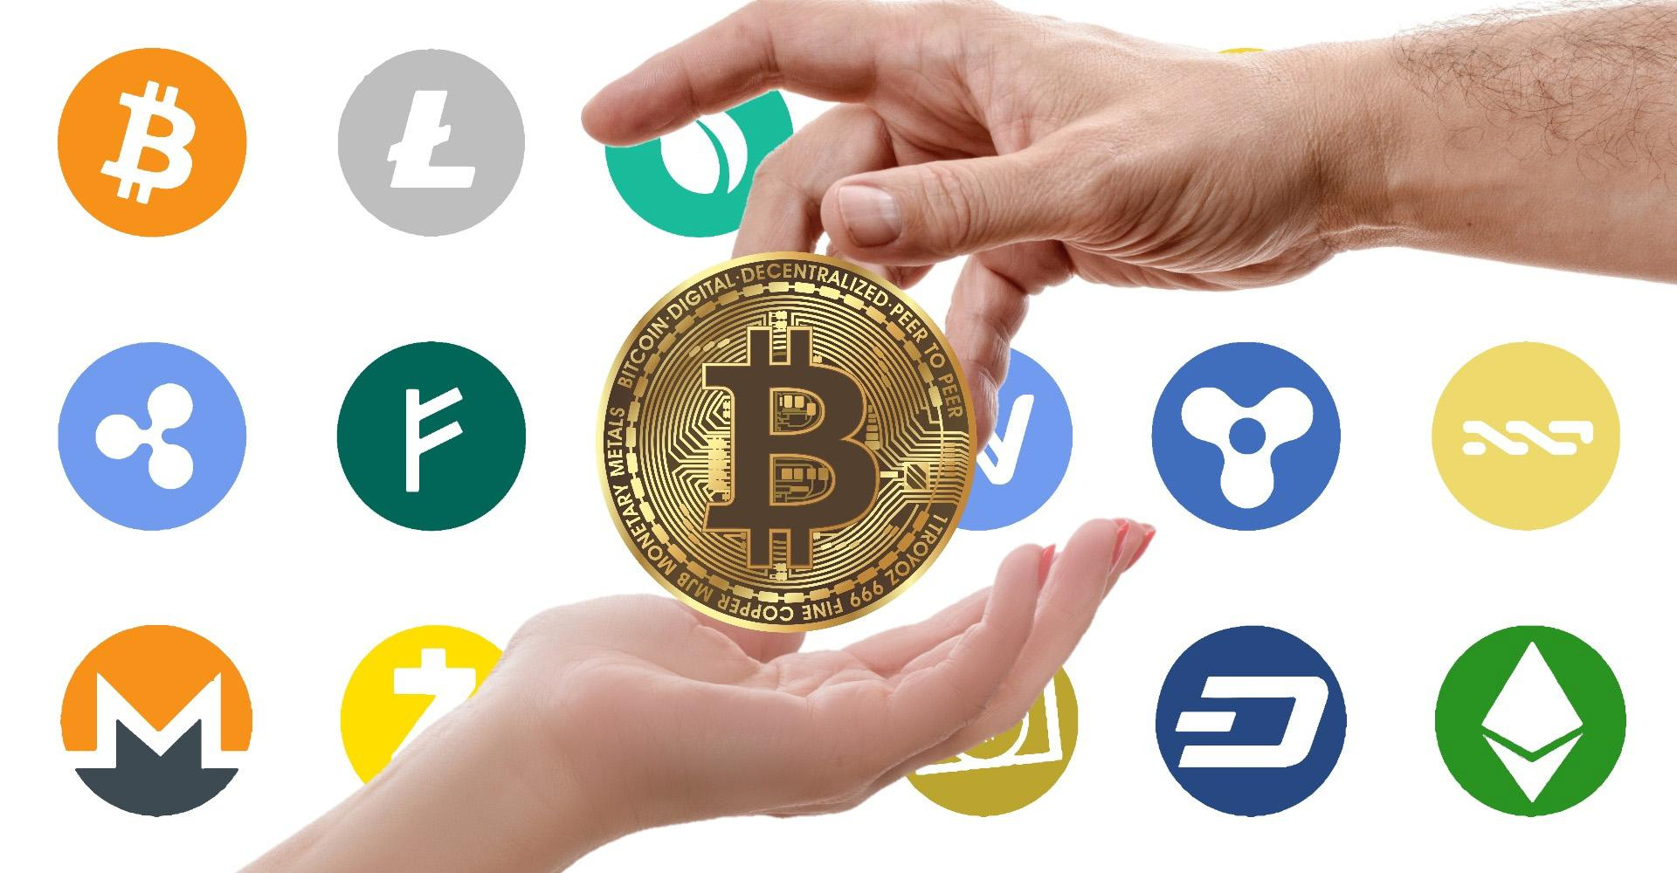
APPLICATIONS
Cryptocurrencies:The legitimacy of cryptocurrency purchases by individuals is ensured as they are able to trace the transfer of the currency to its origin.

Slide 8
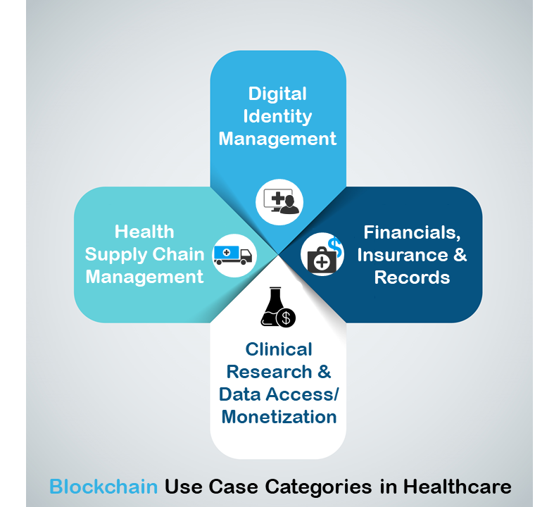
Healthcare:The healthcare industry also undergoes a constant barrage of cyberattacks. In fact, healthcare is experiencing twice the amount of phishing emails and malware attacks of other industries.
The decentralized state of digital ledger allows only certain individuals to have small amounts of information, a patient's entire health chart would be compromised.

Slide 9
METODOLOGY
A blockchain comprises of an administered database of all transactions on a given network.
Each network component of this database represents a “block”. As the state of a transaction changes, a block gets affixed to the blockchain with a reference to the previous block in linearly chronological order.
The new block is then cloned across the network so that each node has the same blockchain.
Every entrant of this transaction has a copy of the blockchain. Thus, any participant can authenticate a given transaction.
This methodology has put an end to the need for having a centralized, trust worthy third-party transaction substantiation.

Slide 10
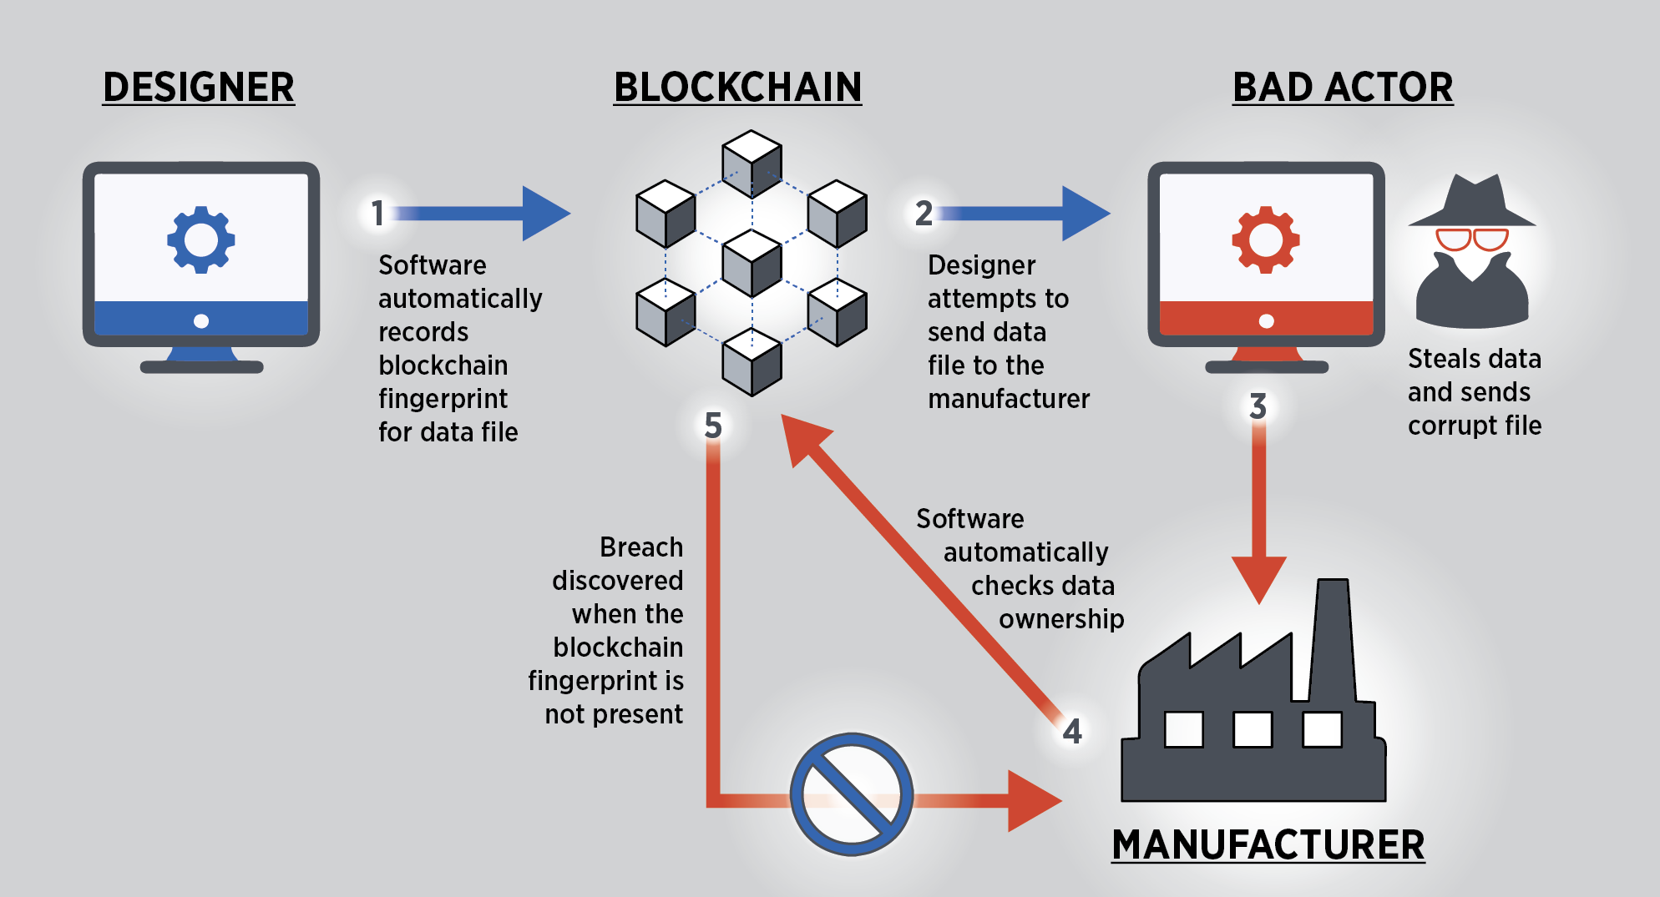
A blockchain technique will certify that the data is from the valid source and that nothing is intervened in the interlude.
Blockchain is more sturdy than the legacy systems in an organization. Thus, blockchain technology minimizes cyber security risk by simply negotiating the need for human intervention.

Slide 11
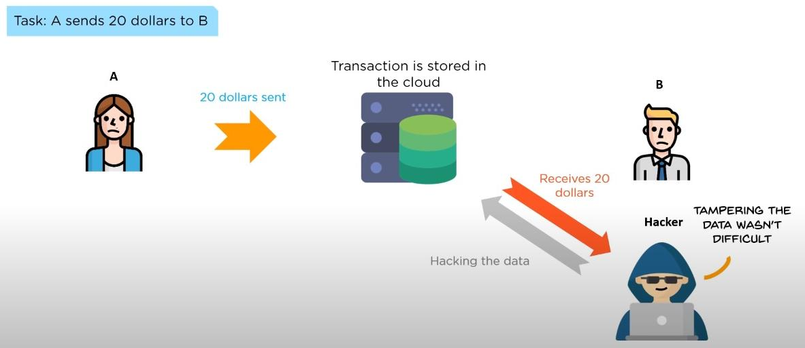
CHALLENGES:The major challenge being the data tampering within which it is leading to security issues

Slide 12

CASE STUDY
Hashed Health
Location:Nashville, Tennessee.

Slide 13
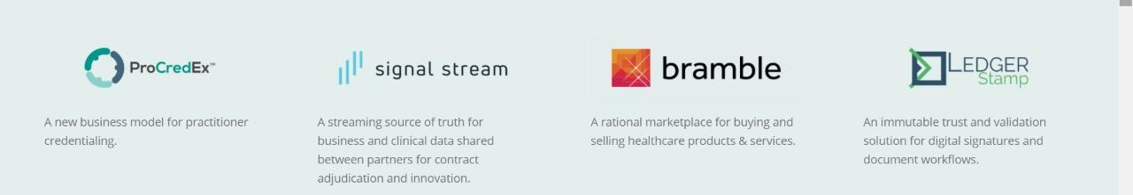
It is a venture studio, driving innovation and collaboration in health care. It has a unique open source of sharing the problem with different softwares such as procredex, signal stream, bramble, ledger stamp.
They run through the process of a hypothesis- driven, intentional, iterative approach in healthcare technology and innovations. They are dedicated to help the industries in implementing blockchain technology. The innovation consists of hashed collective, enterprise, labs etc, which focus on various aspects of blockchain by maintaining a community within.
The company is heading to experiment with different ledger technologies.

Slide 14
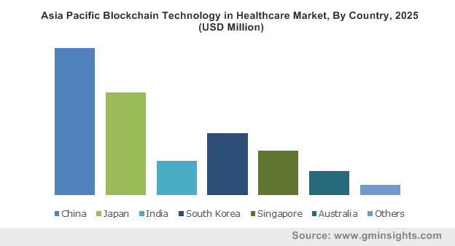
FUTURE SCOPE
The scope of blockchain in healthcare looks super on the up-and-up and promising as it helps to solve majorly found issues affecting the healthcare industry. As blockchain is decentralized unlike other centralized mechanisms in healthcare, it has envisioned a progressive future.
Though it has its own challenges to deal with the process and number of steps to record in finding to get the data can be complex. Nonetheless emerging technologies like Artificial Intelligence and Machine Learning can subdue these problems and bring a better world, free of attacks.

Slide 15
THANK YOU !
K.SRI NITYA

